Slide 1
Boosting Algorithms
AdaBoost, XGBoost, LightGBM

Slide 2
AdaBoost - Overview
Adaptive Boosting
Focus on errors
Sequential learning

Slide 3
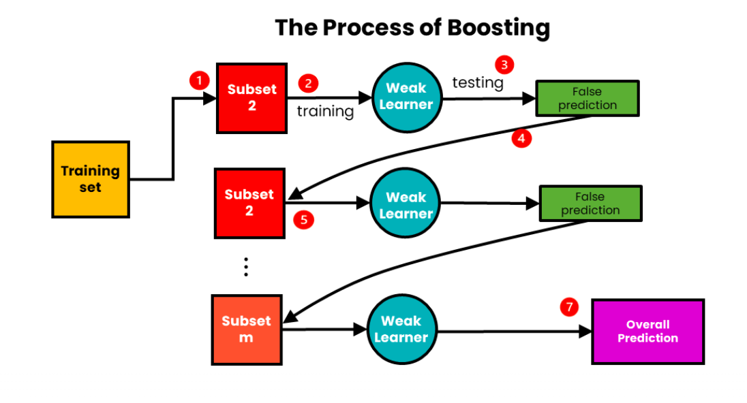
AdaBoost - Working
Assign weights
Increase error weights
Combine models

Slide 4
AdaBoost - Features
Simple
Decision stumps
Sensitive to noise

Slide 5
AdaBoost - Advantages
Easy to use
Improves accuracy

Slide 6
AdaBoost - Disadvantages
Noise sensitive
Overfitting risk

Slide 7
AdaBoost Flow
Data
Final Model
Weak Learner
Weight Update

Slide 8
XGBoost - Overview
Optimized boosting
High performance

Slide 9
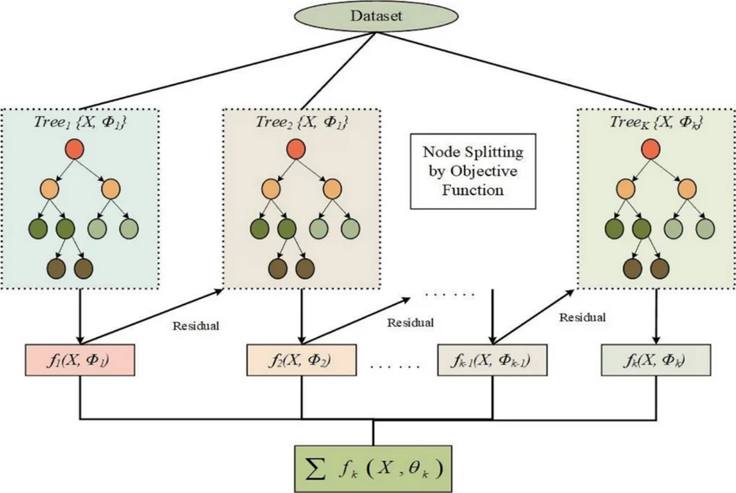
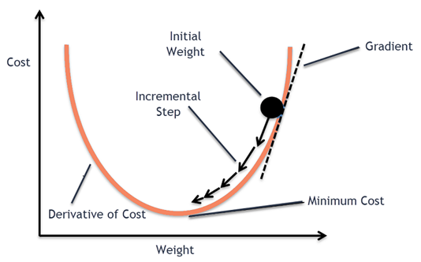
XGBoost - Working
Gradient descent
Sequential trees

Slide 10
XGBoost - Features
Regularization
Parallel processing

Slide 11
XGBoost - Advantages
Accurate
Scalable

Slide 12
XGBoost - Disadvantages
Complex tuning

Slide 13
XGBoost Flow
Data
Tree2
Tree1
Prediction

Slide 14
LightGBM - Overview
Fast boosting
Efficient

Slide 15
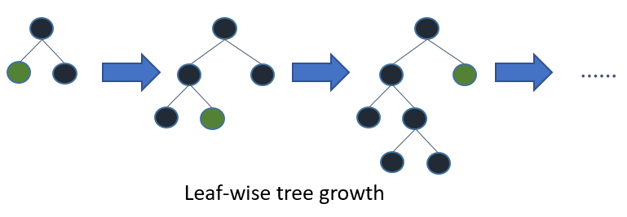
LightGBM - Working
Leaf-wise growth

Slide 16
LightGBM - Features
Histogram based
Low memory

Slide 17
LightGBM - Advantages
Fast
Accurate

Slide 18
LightGBM - Disadvantages
Overfitting risk

Slide 19
LightGBM Flow
Data
Leaf Split
Model
Best Split

Slide 20
Comparison
AdaBoost: Simple
XGBoost: Accurate
LightGBM: Fast

Slide 21
Real World Use Cases
AdaBoost: Face detection
XGBoost: Fraud detection
LightGBM: Recommendation systems

